Slide 1






SALARY survey ANLYSIS – MILESTONE PROJECT
Janarthanan M
DADS – July 2025
Cohort- A

Slide 2


PROJECT OVERVIEW & OBJECTIVES
The project analyzes a salary survey dataset to understand salary trends across different demographics such as age range, gender, education level, job role, and industry.
Excel is used to clean and preprocess the raw data, including handling missing values, removing outliers, formatting text, and converting all salaries to a standard USD currency.
The cleaned dataset is imported into MySQL for deeper analysis using SQL queries to calculate averages, medians, total compensation, and salary distributions.
The project identifies important insights such as the highest-paying job roles, salary differences between genders, and how education or experience affects salary.
The final output helps understand overall compensation patterns and supports better decision-making for salary planning, budgeting, and workforce analysis.

Slide 3




PROJECT GOALS
To clean and standardize the salary survey dataset by handling missing values, removing outliers, formatting text fields, and converting all salaries into USD for accurate comparison.
To analyze salary trends using SQL queries, focusing on how salary varies based on factors like age range, gender, education, industry, job title, and experience levels.
To give meaningful insights that help understand compensation patterns, identify gaps or inequalities, and support better decision-making for salary planning and workforce management.

Slide 4
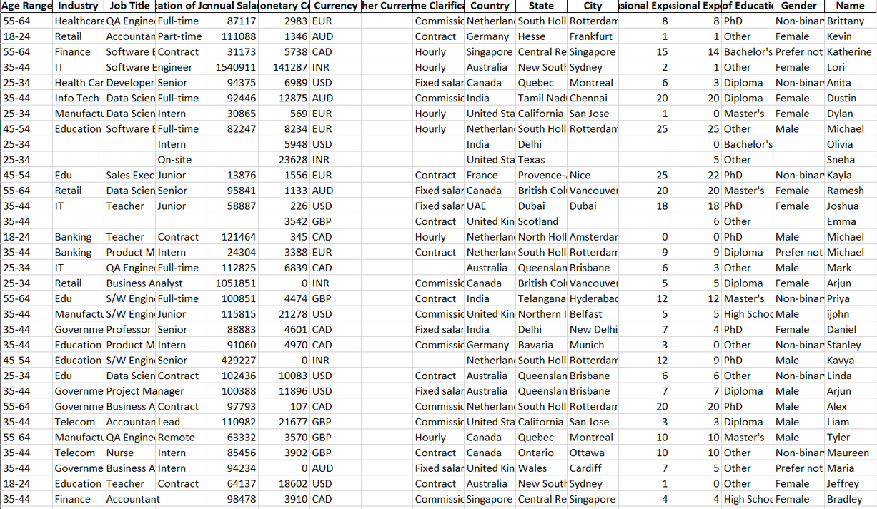
DATASET DESCRIPTION
Dataset: Salary Survey
Key Attributes:
Age Range, Gender, Education
Industry, Job Title, Country, City
Annual Salary, Additional Compensation
Years of Experience (Overall & In Field)
Dataset Size: 1021 rows and 7

Slide 5
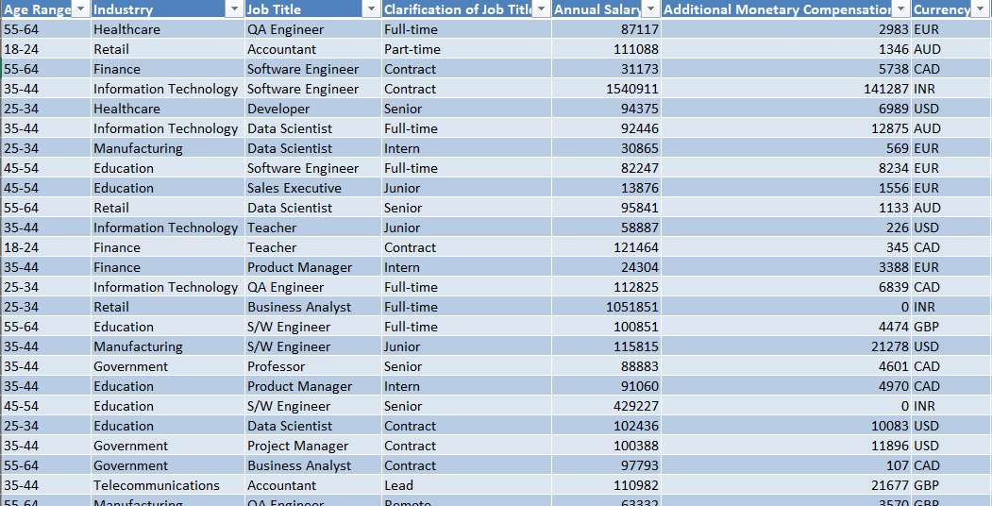
DATA CLEANING
Loaded raw data into Excel Power Query for preprocessing.
Removed rows with multiple null or missing values to maintain data.
Standardized column data types (text, numeric, categorical).
Normalized categorical fields — fixed inconsistent spellings and capitalization
Handled outliers in salary values using domain understanding.
left outliers with more experience rest are filled with median
Verified final dataset quality before exporting to CSV for MySQL import.

Slide 6
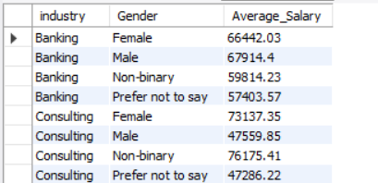
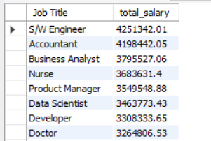
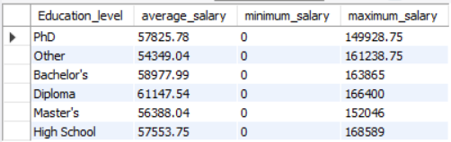
SQL QUERIES
Average Salary by Industry and Gender
Total Compensation by Job Title
Salary Distribution by Education Level (Min, Max, Avg)
Employee Count by Industry and Experience Level
Median Salary by Age Range and Gender
Highest-Paid Job Titles in Each Country
Average Salary by City and Industry
Percentage of Employees Receiving Additional Compensation by Gender
Total Compensation by Job Title and Experience Level
Average Salary by Industry, Gender, and Education Level

Slide 7
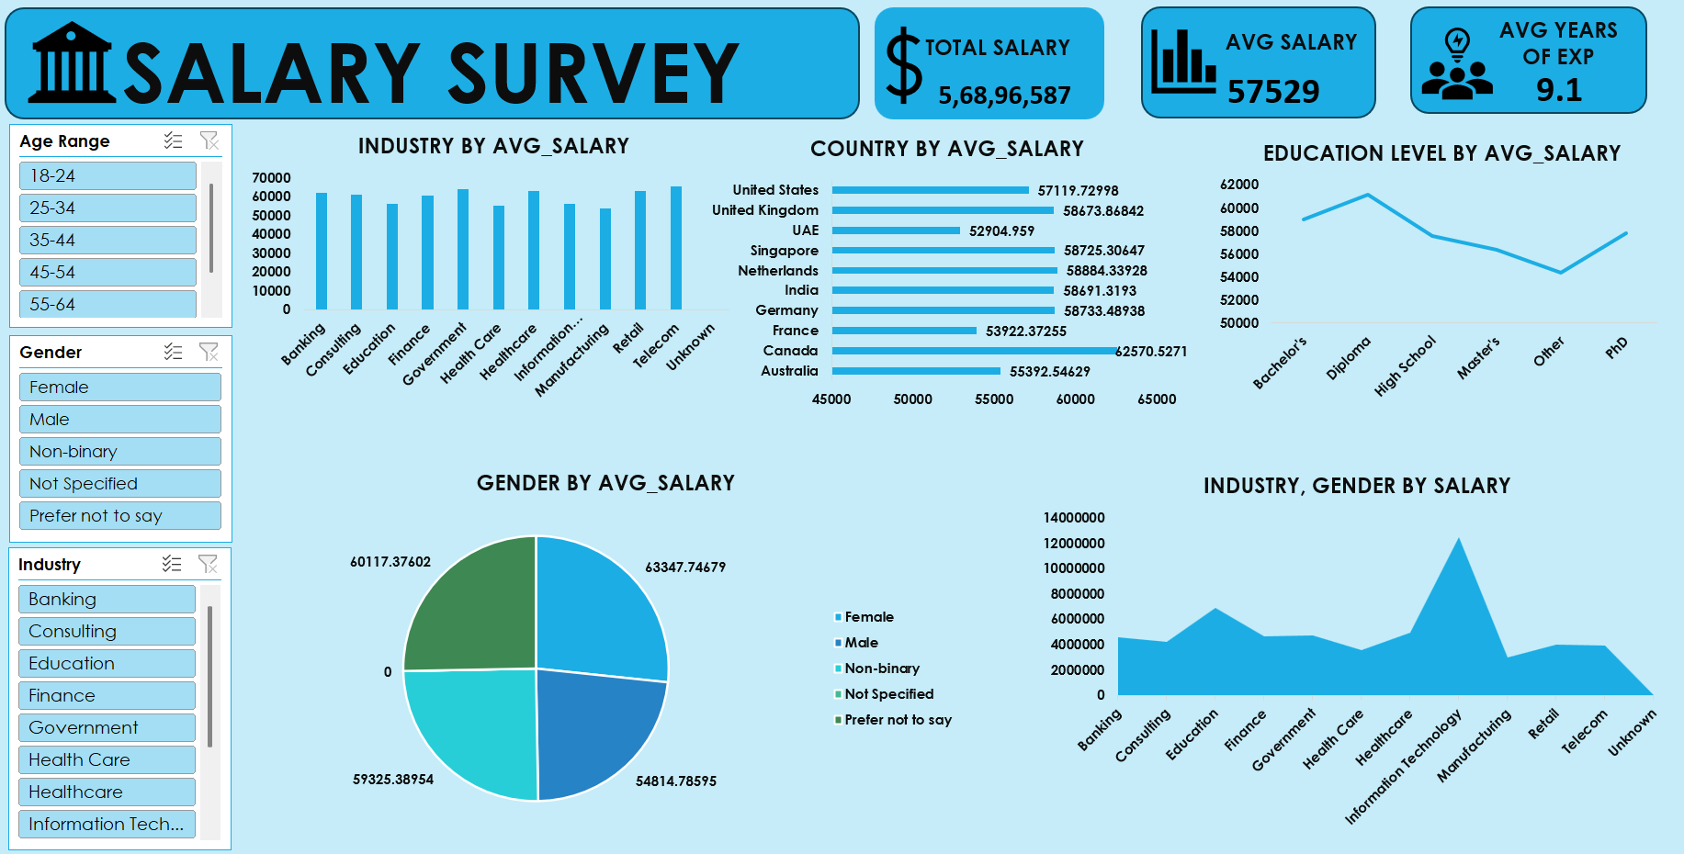
DASHBOARD OVERVIEW
Total Salary
Average Salary
Average Years of Experience
Industry-wise Average Salary
Country-wise Average Salary
Education Level by Average Salary
Gender-wise Average Salary
Industry & Gender Salary Comparison

Slide 8
Insights & Findings
Banking and Telecom show the highest average salaries, indicating strong demand for skilled professionals in these sectors.
Countries like the Canada, United States, Singapore, and the Netherlands have the highest average salaries, reflecting stronger compensation standards in these regions.
Gender-wise salary differences are minimal, showing relatively balanced pay across genders in the dataset.
Employees with Bachelor's degrees and Diplomas earn higher average salaries compared to Master’s degree holders, suggesting early-career technical skills may be highly valued.
The average experience of 9.1 years shows a mostly mid-career workforce, which aligns with the steady and consistent salary trends seen across industries.

Slide 9
Conclusions
The salary survey analysis shows consistent salary ranges across most industries, with Information Technology and Manufacturing offering the highest compensation.
Country-wise comparison highlights that the US, Singapore, and Europe lead in high salary payouts, reflecting stronger global markets.
Education level impacts salary, but not in a linear way—Bachelor’s and Diploma holders earn slightly more than Master's graduates in this dataset.
Gender-based salary variations are minimal, indicating relatively fair pay distribution across genders.
Overall, the dataset represents mainly mid-level professionals (average 9.1 years of experience), which stabilizes salary trends across demographics.

Slide 10
Recommendations
Companies should review salary structures in lower-paying industries to stay competitive and attract skilled professionals.
Countries with lower salary averages may benefit from benchmarking global compensation trends to remain competitive in talent markets.
Organizations can focus on skill-based hiring, as Bachelor's and Diploma holders are performing well in terms of compensation.
Regular pay equity audits should be conducted to maintain fairness across genders and highlight any small emerging gaps.
Employees and job seekers can use these insights to target high-paying industries and locations based on their skills and experience.

Slide 11
THANK YOU

